Slide 2
WG21 San Diego
Обзор встречи
Полухин Антон
Antony Polukhin

Slide 3
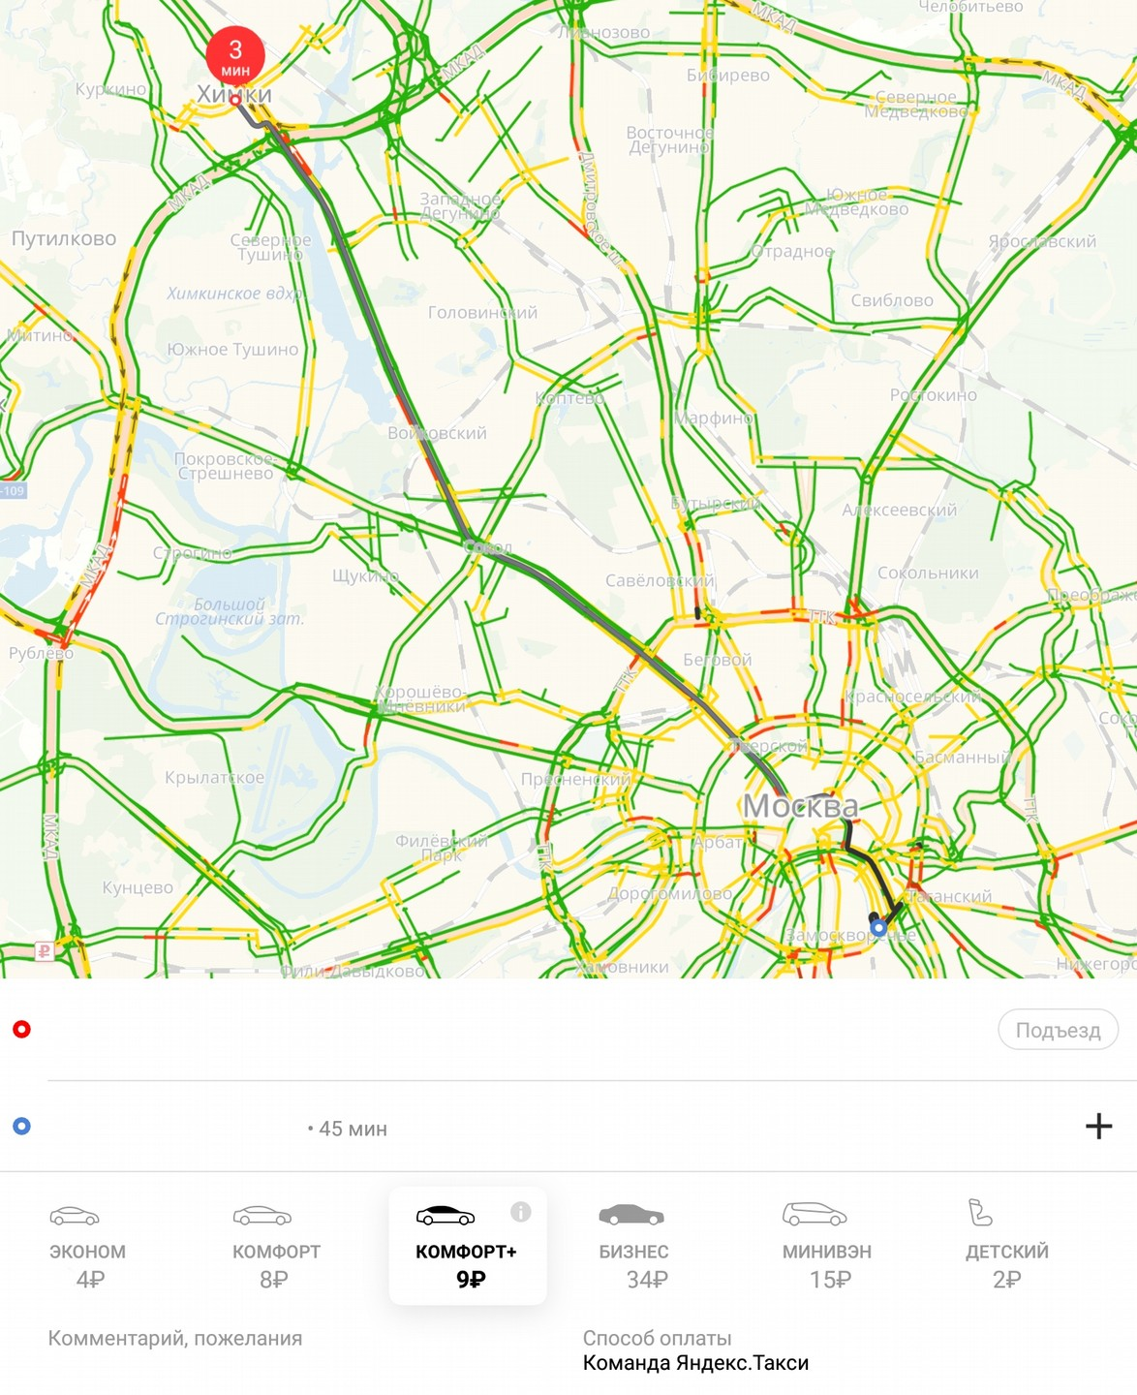
Содержание
C++2a
C++20
Ranges
Modules
char8_t
РГ 21
WG21 San Diego

Slide 4
Ranges
WG21 San Diego

Slide 5
Введение в Ranges
// <algorithm>
namespace std {
template <class InputIterator, class T>
constexpr InputIterator find(InputIterator first, InputIterator last,
const T& value);
} // namespace std
WG21 San Diego
<number> / 66

Slide 6
Введение в Ranges
// <algorithm>
namespace std::ranges {
template <InputIterator I, Sentinel<I> S, class T, class Proj = identity>
requires IndirectRelation<ranges::equal_to<>, projected<I, Proj>, const T*>
constexpr I find(I first, S last, const T& value, Proj proj = {});
template <InputRange R, class T, class Proj = identity>
requires IndirectRelation<ranges::equal_to<>, projected<iterator_t<R>, Proj>, const T*>
constexpr safe_iterator_t<R> find(R&& r, const T& value, Proj proj = {});
} // namespace std::ranges
WG21 San Diego
<number> / 66

Slide 7
Введение в Ranges
// <algorithm>
namespace std::ranges {
template <InputIterator I, Sentinel<I> S, class T, class Proj = identity>
requires IndirectRelation<ranges::equal_to<>, projected<I, Proj>, const T*>
constexpr I find(I first, S last, const T& value, Proj proj = {});
template <InputRange R, class T, class Proj = identity>
requires IndirectRelation<ranges::equal_to<>, projected<iterator_t<R>, Proj>, const T*>
constexpr safe_iterator_t<R> find(R&& r, const T& value, Proj proj = {});
} // namespace std::ranges
WG21 San Diego
<number> / 66

Slide 8
Введение в Ranges
// <algorithm>
namespace std::ranges {
template <InputIterator I, Sentinel<I> S, class T, class Proj = identity>
requires IndirectRelation<ranges::equal_to<>, projected<I, Proj>, const T*>
constexpr I find(I first, S last, const T& value, Proj proj = {});
} // namespace std::ranges
WG21 San Diego
<number> / 66

Slide 9
Введение в Ranges
// <algorithm>
namespace std::ranges {
template <InputIterator I, Sentinel<I> S, class T, class Proj = identity>
requires IndirectRelation<ranges::equal_to<>, projected<I, Proj>, const T*>
constexpr I find(I first, S last, const T& value, Proj proj = {});
} // namespace std::ranges
WG21 San Diego
<number> / 66

Slide 10
Введение в Ranges
// <algorithm>
namespace std::ranges {
template <InputIterator I, Sentinel<I> S, class T, class Proj = identity>
requires IndirectRelation<ranges::equal_to<>, projected<I, Proj>, const T*>
constexpr I find(I first, S last, const T& value, Proj proj = {});
} // namespace std::ranges
const char* char_ptr = "....";
auto it = std::ranges::find(char_ptr, std::unreachable_sentinel, '.');
WG21 San Diego
<number> / 66

Slide 11
Введение в Ranges
// <algorithm>
namespace std::ranges {
template <InputIterator I, Sentinel<I> S, class T, class Proj = identity>
requires IndirectRelation<ranges::equal_to<>, projected<I, Proj>, const T*>
constexpr I find(I first, S last, const T& value, Proj proj = {});
} // namespace std::ranges
const char* char_ptr = "....";
auto it = std::ranges::find(char_ptr, value_sentinel{'\0'}, '.');
WG21 San Diego
<number> / 66

Slide 12
Введение в Ranges
// <algorithm>
namespace std::ranges {
template <InputIterator I, Sentinel<I> S, class T, class Proj = identity>
requires IndirectRelation<ranges::equal_to<>, projected<I, Proj>, const T*>
constexpr I find(I first, S last, const T& value, Proj proj = {});
} // namespace std::ranges
WG21 San Diego
<number> / 66

Slide 13
Введение в Ranges
// <algorithm>
namespace std::ranges {
template <InputIterator I, Sentinel<I> S, class T, class Proj = identity>
requires IndirectRelation<ranges::equal_to<>, projected<I, Proj>, const T*>
constexpr I find(I first, S last, const T& value, Proj proj = {});
} // namespace std::ranges
WG21 San Diego
<number> / 66

Slide 14
Введение в Ranges
// <algorithm>
namespace std::ranges {
template <InputIterator I, Sentinel<I> S, class T, class Proj = identity>
requires IndirectRelation<ranges::equal_to<>, projected<I, Proj>, const T*>
constexpr I find(I first, S last, const T& value, Proj proj = {});
} // namespace std::ranges
WG21 San Diego
<number> / 66

Slide 15
Введение в Ranges
// <algorithm>
namespace std::ranges {
template <InputIterator I, Sentinel<I> S, class T, class Proj = identity>
requires IndirectRelation<ranges::equal_to<>, projected<I, Proj>, const T*>
constexpr I find(I first, S last, const T& value, Proj proj = {});
} // namespace std::ranges
std::unordered_map<int, std::string> map = {....};
auto it = std::ranges::find(map.cbegin(), map.cend(), "Hello"sv,
[](const auto& v) -> std::string_view { return v.second; });
WG21 San Diego
<number> / 66

Slide 16
Введение в Ranges
// <algorithm>
namespace std::ranges {
template <InputIterator I, Sentinel<I> S, class T, class Proj = identity>
requires IndirectRelation<ranges::equal_to<>, projected<I, Proj>, const T*>
constexpr I find(I first, S last, const T& value, Proj proj = {});
template <InputRange R, class T, class Proj = identity>
requires IndirectRelation<ranges::equal_to<>, projected<iterator_t<R>, Proj>, const T*>
constexpr safe_iterator_t<R> find(R&& r, const T& value, Proj proj = {});
} // namespace std::ranges
WG21 San Diego
<number> / 66

Slide 17
Введение в Ranges
// <algorithm>
namespace std::ranges {
template <InputIterator I, Sentinel<I> S, class T, class Proj = identity>
requires IndirectRelation<ranges::equal_to<>, projected<I, Proj>, const T*>
constexpr I find(I first, S last, const T& value, Proj proj = {});
template <InputRange R, class T, class Proj = identity>
requires IndirectRelation<ranges::equal_to<>, projected<iterator_t<R>, Proj>, const T*>
constexpr safe_iterator_t<R> find(R&& r, const T& value, Proj proj = {});
} // namespace std::ranges
WG21 San Diego
<number> / 66

Slide 18
Введение в Ranges
// <algorithm>
namespace std::ranges {
template <InputRange R, class T, class Proj = identity>
requires IndirectRelation<ranges::equal_to<>, projected<iterator_t<R>, Proj>, const T*>
constexpr safe_iterator_t<R> find(R&& r, const T& value, Proj proj = {});
} // namespace std::ranges
WG21 San Diego
<number> / 66

Slide 19
Введение в Ranges
// <algorithm>
namespace std::ranges {
template <InputRange R, class T, class Proj = identity>
requires IndirectRelation<ranges::equal_to<>, projected<iterator_t<R>, Proj>, const T*>
constexpr safe_iterator_t<R> find(R&& r, const T& value, Proj proj = {});
} // namespace std::ranges
WG21 San Diego
<number> / 66

Slide 20
Введение в Ranges
// <algorithm>
namespace std::ranges {
template <InputRange R, class T, class Proj = identity>
requires IndirectRelation<ranges::equal_to<>, projected<iterator_t<R>, Proj>, const T*>
constexpr safe_iterator_t<R> find(R&& r, const T& value, Proj proj = {});
} // namespace std::ranges
const char data[] = "....";
auto it = std::ranges::find(data, '.');
WG21 San Diego
<number> / 66

Slide 21
Введение в Ranges
// <algorithm>
namespace std::ranges {
template <InputRange R, class T, class Proj = identity>
requires IndirectRelation<ranges::equal_to<>, projected<iterator_t<R>, Proj>, const T*>
constexpr safe_iterator_t<R> find(R&& r, const T& value, Proj proj = {});
} // namespace std::ranges
std::unordered_map<int, std::string> map = {....};
auto it = std::ranges::find(map, "Hello"sv,
[](const auto& v) -> std::string_view { return v.second; });
WG21 San Diego
<number> / 66

Slide 22
Ranges
Часть 2
WG21 San Diego

Slide 23
Views
// <ranges>
namespace std::view {
inline constexpr unspecified transform = unspecified;
inline constexpr unspecified filter = unspecified;
inline constexpr unspecified join = unspecified;
inline constexpr unspecified split = unspecified;
inline constexpr unspecified iota = unspecified;
inline constexpr unspecified reverse = unspecified;
inline constexpr unspecified counted = unspecified;
} // namespace std::view
WG21 San Diego
<number> / 66

Slide 24
Views
#include <ranges>
std::string str = "abcd";
WG21 San Diego
<number> / 66

Slide 25
Views
#include <ranges>
std::string str = "abcd";
for (auto c : std::view::reverse(str)) {
std::cout << c;
}
WG21 San Diego
<number> / 66

Slide 26
Views
#include <ranges>
std::string str = "abcd";
for (auto c : std::view::reverse(str)) {
std::cout << c;
}
std::ranges::copy(std::view::reverse(str), std::ostream_iterator<char>(std::cout));
WG21 San Diego
<number> / 66

Slide 27
Views
#include <ranges>
std::string_view str = "Ranges! Are! Awesome!";
for (auto word : std::view::split(str, ' ')) {
std::ranges::copy(word, std::ostream_iterator<char>(std::cout));
std::cout << '\n';
}
WG21 San Diego
<number> / 66

Slide 28
Views
#include <ranges>
std::string_view str = "Ranges! Are! Awesome!";
for (auto word : std::view::split(str, ' ')) {
std::ranges::copy(word, std::ostream_iterator<char>(std::cout));
std::cout << '\n';
}
// "Ranges!\nAre!\nAwesome!\n"
WG21 San Diego
<number> / 66

Slide 29
Views
#include <ranges>
std::string_view str = "Ranges! Are! Awesome!";
for (auto word : str | std::view::split(' ')) {
std::ranges::copy(word, std::ostream_iterator<char>(std::cout));
std::cout << '\n';
}
WG21 San Diego
<number> / 66

Slide 30
Views
#include <ranges>
std::string_view str = "Ranges! Are! Awesome!";
for (auto word : str | std::view::split(' ')) {
std::ranges::copy(word, std::ostream_iterator<char>(std::cout));
std::cout << '\n';
}
// "Ranges!\nAre!\nAwesome!\n"
WG21 San Diego
<number> / 66

Slide 31
Views
#include <ranges>
std::string_view str = "Ranges! Are! Awesome!";
constexpr auto f = [](char c) { return c != '!'; };
for (auto word : str | std::view::filter(f) | std::view::split(' ')) {
std::ranges::copy(word, std::ostream_iterator<char>(std::cout));
std::cout << '\n';
}
// "Ranges\nAre\nAwesome\n"
WG21 San Diego
<number> / 66

Slide 32
Views
#include <ranges>
std::string_view str = "Ranges! Are! Awesome!";
constexpr auto f = [](char c) { return c != '!'; };
constexpr auto t = [](char c) { return std::tolower(c); };
using namespace v = std::view;
for (auto word : str | v::filter(f) | v::transform(t) | v::split(' ')) {
std::ranges::copy(word, std::ostream_iterator<char>(std::cout));
std::cout << '|';
}
// "ranges|are|awesome|"
WG21 San Diego
<number> / 66

Slide 33
Views
#include <ranges>
#include <algorithm>
#include <cctype>
template <class T> bool is_palindrome(const T& str) {
using namespace v = std::view;
auto f = str | v::filter([](int x) { return std::isalpha(x); })
| v::transform([](auto x) { return std::tolower(x); });
return std::ranges::equal(f, v::reverse(f));
}
assert(is_palindrome("Madam, I'm Adam"));
WG21 San Diego
<number> / 66

Slide 34
Terse syntax
WG21 San Diego

Slide 35
Views
#include <ranges>
#include <algorithm>
#include <cctype>
template <class T>
requires BidirectionalRange<T>
bool is_palindrome(const T& str);
WG21 San Diego
<number> / 66

Slide 36
Views
#include <ranges>
#include <algorithm>
#include <cctype>
bool is_palindrome(const BidirectionalRange auto& str);
WG21 San Diego
<number> / 66

Slide 37
Modules
WG21 San Diego

Slide 38
Modules
WG21 San Diego

Slide 39
char8_t
WG21 San Diego

Slide 40
char8_t
char8_t hello0[] = u8"Из РГ21 с лбовью!";
WG21 San Diego
<number> / 66

Slide 41
char8_t
char8_t hello0[] = u8"Из РГ21 с лбовью!";
std::u8string hello = u8"Из РГ21 с лбовью!";
WG21 San Diego
<number> / 66

Slide 42
char8_t
char8_t hello0[] = u8"Из РГ21 с лбовью!";
std::u8string hello = u8"Из РГ21 с лбовью!";
// std::cout << hello; // fail
WG21 San Diego
<number> / 66

Slide 43
char8_t
void do_something(unsigned char* data, int& result) {
result += data[0] - u8'0';
result += data[1] - u8'0';
}
void do_something(char8_t* data, int& result) {
result += data[0] - u8'0';
result += data[1] - u8'0';
}
WG21 San Diego
<number> / 66

Slide 44
char8_t
void do_something(unsigned char* data, int& result) {
result += data[0] - u8'0';
result += data[1] - u8'0';
}
void do_something(char8_t* data, int& result) {
result += data[0] - u8'0';
result += data[1] - u8'0';
}
WG21 San Diego
<number> / 66

Slide 45
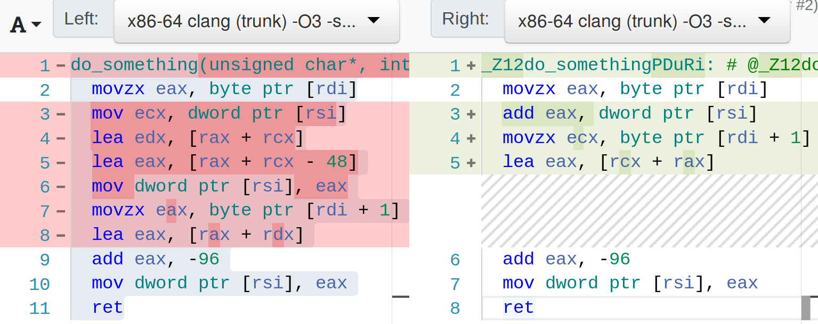
char8_t
WG21 San Diego
<number> / 66

Slide 46
char8_t
void do_something(unsigned char* data, int& result) {
result += data[0] - u8'0';
result += data[1] - u8'0';
}
void do_something(char8_t* data, int& result) {
result += data[0] - u8'0';
result += data[1] - u8'0';
}
WG21 San Diego
<number> / 66

Slide 47
char8_t
void do_something(unsigned char* data, int& result) {
result += data[0] - u8'0';
result += data[1] - u8'0';
}
void do_something(char8_t* data, int& result) {
result += data[0] - u8'0';
result += data[1] - u8'0';
}
WG21 San Diego
<number> / 66

Slide 48
char8_t
void do_something(unsigned char* data, int& result) {
result += data[0] - u8'0';
result += data[1] - u8'0';
}
void do_something(char8_t* data, int& result) {
result += data[0] - u8'0';
result += data[1] - u8'0';
}
WG21 San Diego
<number> / 66

Slide 49
char8_t
WG21 San Diego
<number> / 66

Slide 50
РГ21
WG21 San Diego

Slide 51
РГ21:
* Stacktrace
std::stacktrace s;
std::cout << s;
WG21 San Diego
<number> / 66

Slide 52
РГ21:
* Stacktrace
* Variant comparisons
std::variant<int, std::string> v;
v = 42;
assert(v == 42); // Compile time error!
WG21 San Diego
<number> / 66

Slide 53
РГ21:
* Stacktrace
* Variant comparisons
* Realloc (презентовали)
bool std::allocator_traits<A>::realloc(...)
WG21 San Diego
<number> / 66

Slide 54
РГ21:
* Stacktrace
* Variant comparisons
* Realloc (презентовали)
capacity
free memory
WG21 San Diego
<number> / 66

Slide 55
РГ21:
* Stacktrace
* Variant comparisons
* Realloc (презентовали)
template <class T>
using pool_vector
= std::vector<T, pool_allocator<T, N>>;
WG21 San Diego
<number> / 66

Slide 56
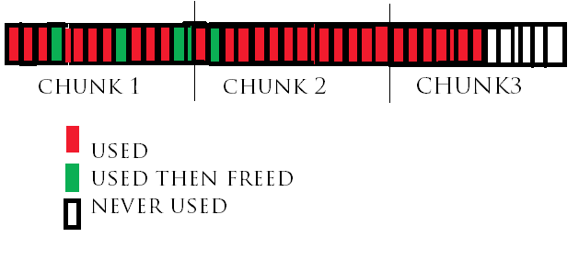
РГ21:
* Stacktrace
* Variant comparisons
* Realloc (презентовали)
template <class T>
using pool_vector
= std::vector<T, pool_allocator<T, N>>;
WG21 San Diego
<number> / 66

Slide 57
РГ21:
* Stacktrace
* Variant comparisons
* Realloc (презентовали)
* Concurrent unordered hash map
WG21 San Diego
<number> / 66

Slide 58
РГ21:
* Stacktrace
* Variant comparisons
* Realloc (презентовали)
* Concurrent unordered hash map
* Numbers
WG21 San Diego
<number> / 66

Slide 59
РГ21:
* Stacktrace
* Variant comparisons
* Realloc (презентовали)
* Concurrent unordered hash map
* Numbers
* [[shared]] (сопереживали)
WG21 San Diego
<number> / 66

Slide 60
РГ21:
* Stacktrace
* Variant comparisons
* Realloc (презентовали)
* Concurrent unordered hash map
* Numbers
* [[shared]] (сопереживали)
* Plugins
WG21 San Diego
<number> / 66

Slide 61
РГ21:
* Stacktrace
* Variant comparisons
* Realloc (презентовали)
* Concurrent unordered hash map
* Numbers
* [[shared]] (сопереживали)
* Plugins
* Constexpr misc
WG21 San Diego
<number> / 66

Slide 62
РГ21:
* Stacktrace
* Variant comparisons
* Realloc (презентовали)
* Concurrent unordered hash map
* Numbers
* [[shared]] (сопереживали)
* Plugins
* Constexpr misc
* Ultimate copy elisions
WG21 San Diego
<number> / 66

Slide 63
РГ21:
* Stacktrace
* Variant comparisons
* Realloc (презентовали)
* Concurrent unordered hash map
* Numbers
* [[shared]] (сопереживали)
* Plugins
* Constexpr misc
* Ultimate copy elisions
T produce(); T update(T b); T shrink(T c);
T d = shrink(update(produce()));
WG21 San Diego
<number> / 66

Slide 64
РГ21:
* Stacktrace
* Variant comparisons
* Realloc (презентовали)
* Concurrent unordered hash map
* Numbers
* [[shared]] (сопереживали)
* Plugins
* Constexpr misc
* Ultimate copy elisions
T produce(); T update(T b); T shrink(T c);
T d = shrink(update(produce()));
WG21 San Diego
<number> / 66

Slide 65
Спасибо

Slide 66

Полухин Антон
Старший разработчик Yandex.Taxi
antoshkka@gmail.com
antoshkka@yandex-team.ru
https://github.com/apolukhin
https://stdcpp.ru/

